Slide 1

Shaking Things Up: Mastering React Component Library Optimization
Asaf Shochet Avida

Slide 2
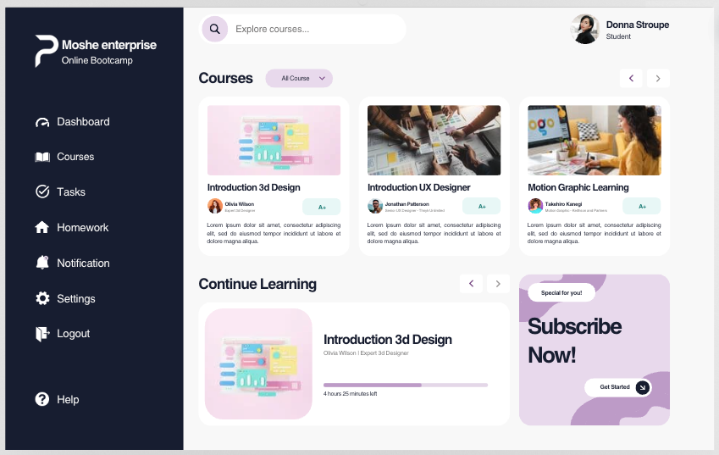
Story
Notes:
3 Founders meet, create their first product, company grows, a second and thirs products are created. Engineering says – hey let’s create a component library with graphs, buttons, tables, loaders.
Yey! Say the founders
Product 4 steps in, needs only a button, imports the library, and BAM, the project works, but it’s a page with a single button, that weights 5MB. That’s not necessary!
Today we’re going to learn how to enjoy the richness of a component library, and the comfort of importing only parts of it.

Slide 3
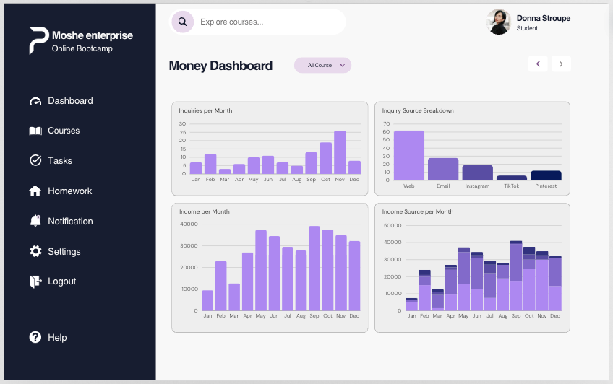
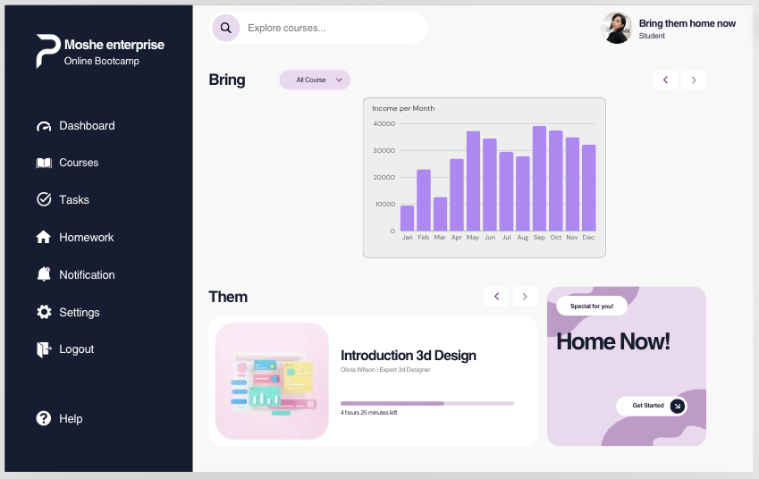
Company Grows
Notes:
3 Founders meet, create their first product, company grows, a second and thirs products are created. Engineering says – hey let’s create a component library with graphs, buttons, tables, loaders.
Yey! Say the founders
Product 4 steps in, needs only a button, imports the library, and BAM, the project works, but it’s a page with a single button, that weights 5MB. That’s not necessary!
Today we’re going to learn how to enjoy the richness of a component library, and the comfort of importing only parts of it.

Slide 4
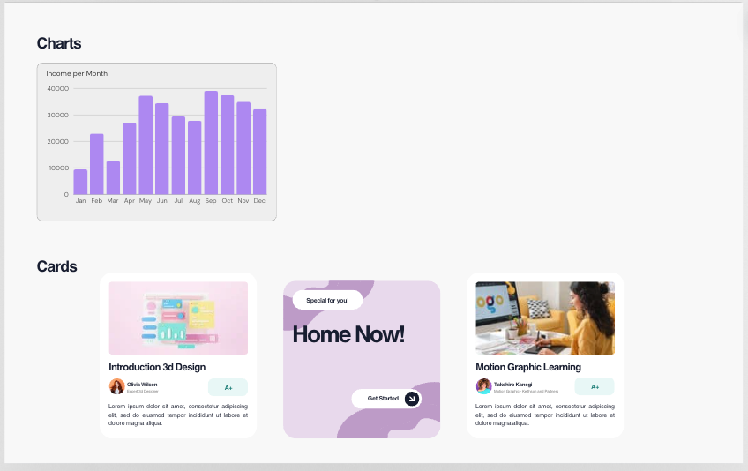
Enters the component library
Notes:
3 Founders meet, create their first product, company grows, a second and thirs products are created. Engineering says – hey let’s create a component library with graphs, buttons, tables, loaders.
Yey! Say the founders
Product 4 steps in, needs only a button, imports the library, and BAM, the project works, but it’s a page with a single button, that weights 5MB. That’s not necessary!
Today we’re going to learn how to enjoy the richness of a component library, and the comfort of importing only parts of it.

Slide 5
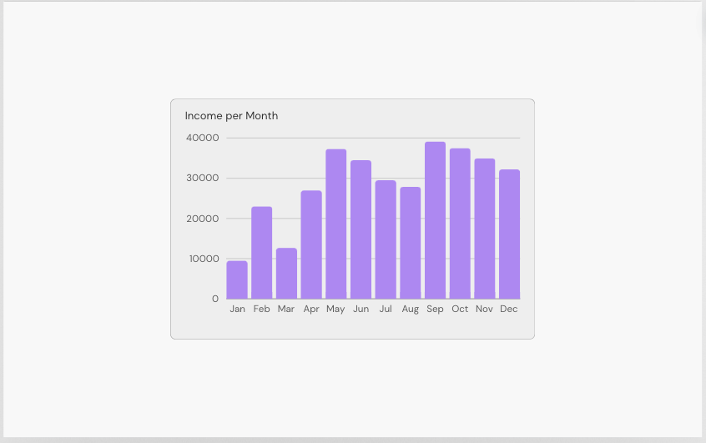
New App
5MB!
🙀
Notes:
3 Founders meet, create their first product, company grows, a second and thirs products are created. Engineering says – hey let’s create a component library with graphs, buttons, tables, loaders.
Yey! Say the founders
Product 4 steps in, needs only a button, imports the library, and BAM, the project works, but it’s a page with a single button, that weights 5MB. That’s not necessary!
Today we’re going to learn how to enjoy the richness of a component library, and the comfort of importing only parts of it.

Slide 6
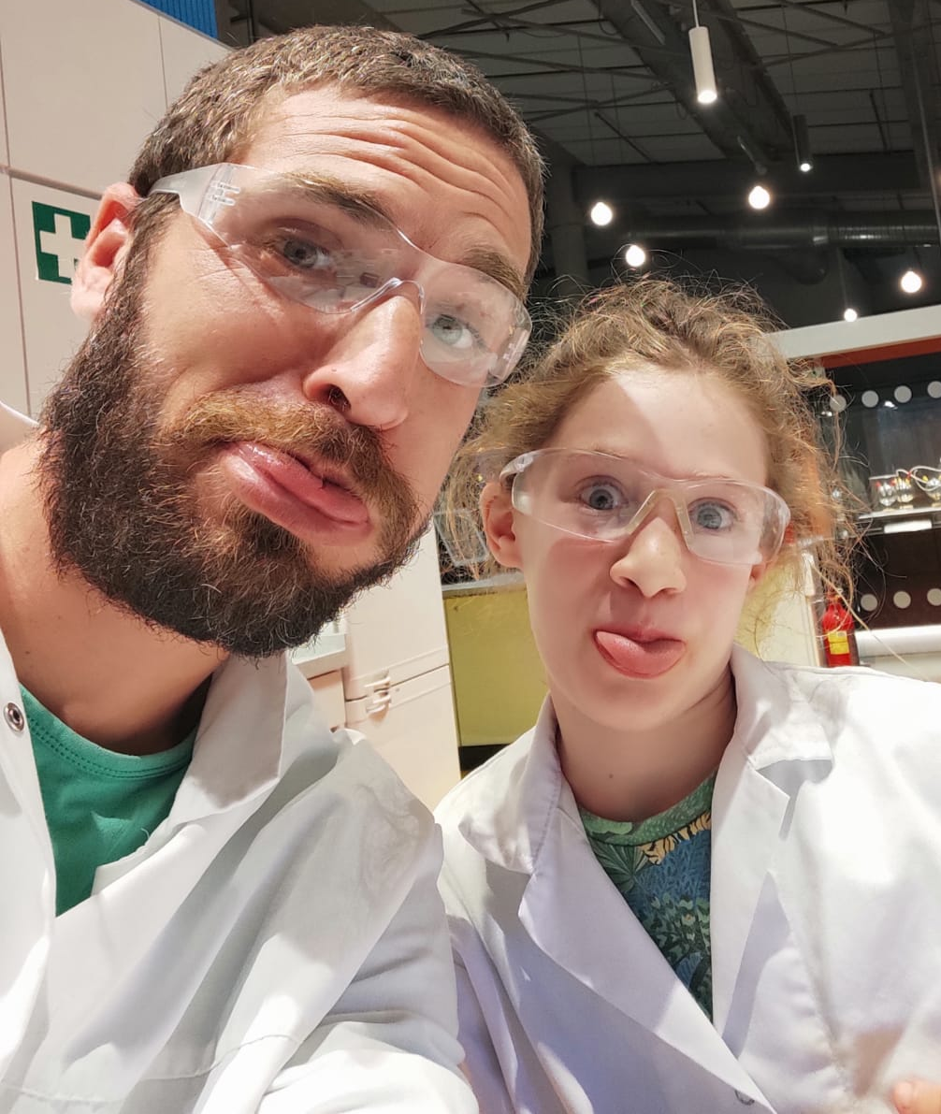



Speaker introduction
Asaf Shochet Avida
Frontend Tech Lead @Evinced
asaf-shochet frogrammer.net
Notes:
I’m the father of Eitan, Sahar and Aviv, Married to Neta
I’m the frontend tech lead at Evinced, an amazing startup the help large organizations make their apps and web apps accessible using technologies like AI, Computer vision to detect accessibility issues, accessibility web crawlers, and… web extensions, where I got familiar with this subject.
While working on our own chrome extensions, based on my interest in security, I started exploring the different capabilities chrome extensions have but from an attacker’s perspective, and that got me thinking.

Slide 7
Agenda
What is tree shaking?
Benefits
Optimize a component library )Coding)
Checklist
Touching Summary

Slide 8
What is tree shaking?
A technique to keep our product code concise by bundling only what’s needed

Slide 9

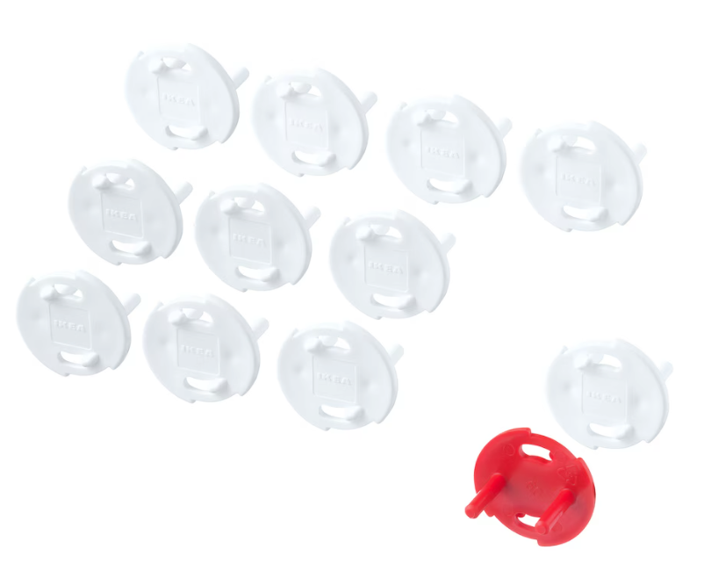
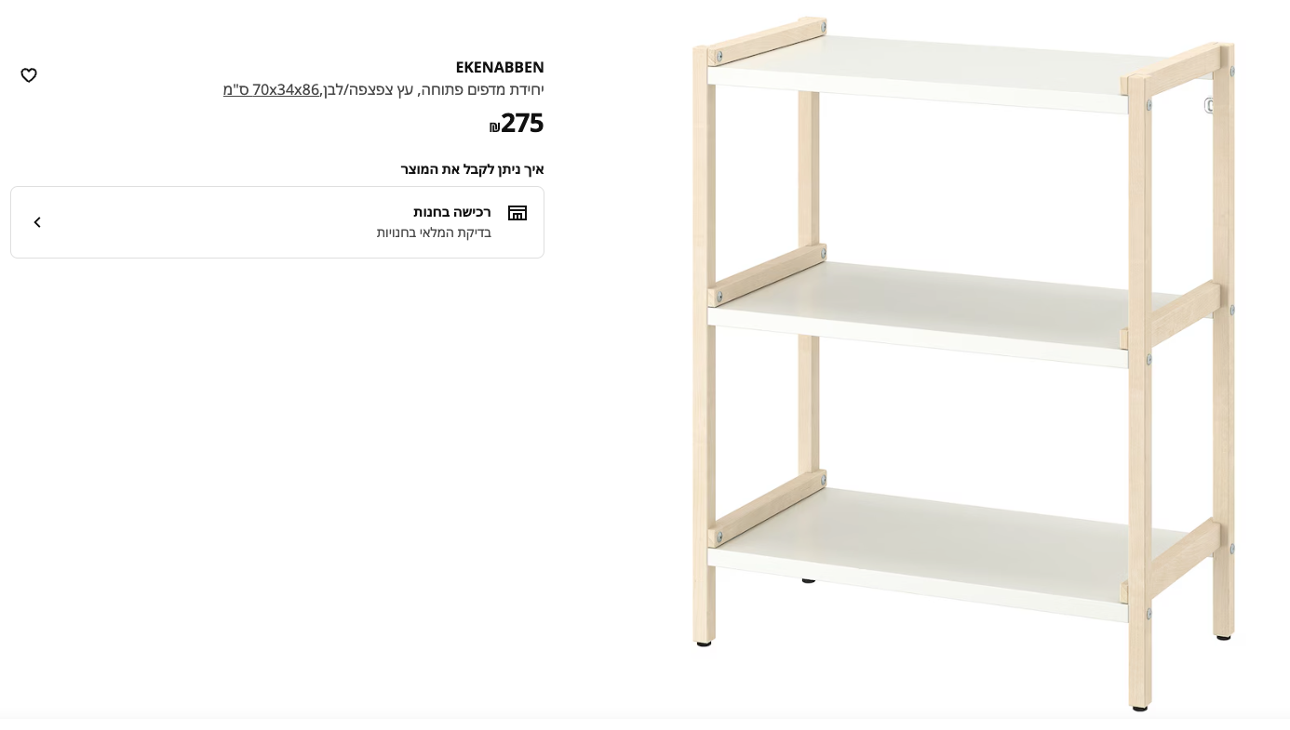
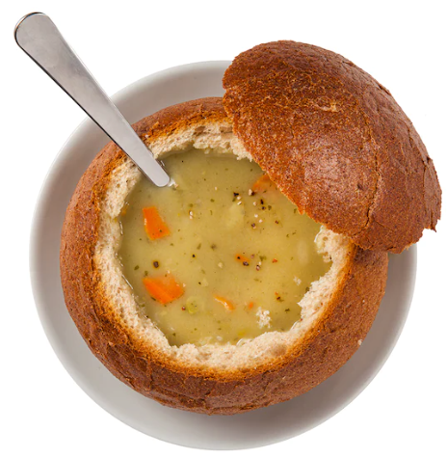
What is tree shaking?
A technique to keep our product code concise by bundling only what’s needed

Slide 10
Why?
Bundle size
CPU (less to process)
Security
Unexpected bugs

Slide 11
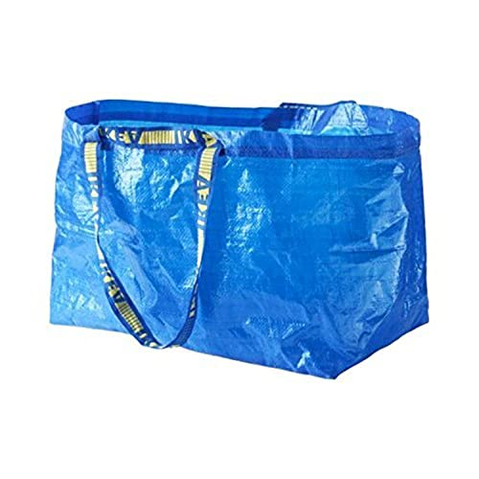
Javascript module systems
Common JS (CJS)
const foo = require(‘foo’);
Ecma Script Module (ESM)
import foo from ”Foo”;

Slide 12
And now
Let’s start coding! (Moving to code editor after this slide)
Code Code Code Code Code Code Code Code Code Code Code Code Code Code Code Code Code Code Code Code Code Code Code Code Code Code Code Code Code Code Code Code Code Code Code Code Code Code Code Code Code Code Code Code Code Code Code Code Code Code Code Code Code Code Code Code Code Code Code Code Code Code Code Code Code Code Code Code Code Code Code Code Code Code Code Code Code Code Code Code Code Code Code Code Code Code Code Code Code Code Code Code Code Code Code Code Code Code Code Code Code Code Code Code Code Code Code Code Code Code Code Code Code Code Code Code Code Code Code Code Code Code Code Code Code Code Code Code Code Code Code Code Code Code Code Code Code Code Code Code Code Code Code Code Code Code Code Code Code Code Code Code Code Code Code Code Code Code Code Code Code Code Code Code Code Code Code Code Code Code Code Code Code Code Code Code Code Code Code Code Code Code Code Code Code Code Code Code Code Code Code Code Code Code Code Code Code Code Code Code Code Code Code Code Code Code Code Code Code Code Code Code Code Code Code Code Code Code Code Code Code Code Code Code Code Code Code Code Code Code Code Code Code Code Code Code Code Code Code Code Code Code Code Code Code Code Code Code Code Code Code Code.
Code.
Notes:
Add a button
Show that the code is injected to the page, and send events
Track urls
=> go to a bank site
Listen to keyboard
Hijack data from local storage
Screenshots

Slide 13
1. Base
2. Output as module (package.json) + rollup
3. Named exports
4. Side Effects
5. lodash
Output as module
"module": "dist/src/index.js",
Change to named exports
Index.tsx + index.ts

Slide 14
Webpack
Modify cjs to esm
Change way to export
Define tree shaking on consumer
Production vs development
BundleAnalyzerPlugin

Slide 15
original
Export as esm
Named exports
Peer dependencies
Export with modules config

Slide 16
Tree Shaking Checklist
Export as esm
Make modules independent
Prefer named exports (linter === ❤️)
Monitor size (it breaks easily)
Keep an eye on dependencies
Sometimes it won’t work

Slide 17
Touching Summary
Spoke about IKEA
Created a startup generator
Optimized it
4. Where to start?

Slide 18
Thanks for listening!
Asaf Shochet Avida
asaf-shochet frogrammer.net We Are Hiring!

